Slide 1

Alion Semantic Mediation Bus™: An Ontology-based Runtime Infrastructure for Service Interoperability
alionscience.com/semantic

Slide 2
Agenda
Background: SOA and Semantic Technology
Semantic Service Provisioning
Semantic Mediation
Foundation for a Semantic Enterprise

Slide 3
Semantics to Solutions
SOA
Foundation for Service Interoperability
Alion Semantic
Mediation Bus™
Runtime infrastructure enables semantic interoperability through common ontologies, even if the services are implemented using different data models and message standards.
Semantics
Common Understanding of Business Concepts
Problems
How I can improve Interoperability between different services and reduce system integration costs?
I have already invested a lot in my SOA infrastructure, how do I leverage it for for Semantic Interoperability?
How can Semantics help reduce service development cost and help my enterprise operations?

Slide 4
SOA: Benefits and Limitations
Service Oriented Architecture (SOA)
  Key Benefits:
    Provides standards based mechanism to access Services at the transport and protocol level
    Promotes re-use of existing services
    Enables fast adaptation to business needs
    Aligns information resources to business goals
  Limitations:
    Current Web Service standards provide the syntactic description of the service interface, but do not describe the meaning or the semantics of the data or behavior. Hence the consumer of the service; whether another service or a human, needs to have intimate knowledge and awareness about the data and its elements
    Current Enterprise Service Buses (ESBs) don’t have an out of the box ability to perform Semantic Mediation, that is the transformation and co-relation of data elements and services based on a pre-defined vocabulary
    Manual intervention and deep domain knowledge is required to develop custom mappings to correctly use data exposed by these related but different Web Services

Slide 5




SOA Silos
Airline Code Lookup Table
Data: UA
HR Army
Field Name:
Commercial Flight
Data: 122
Flight Track Display
FAA Flight Track Web Service
Reference
User
1
Human Communication
3
1
AF SME
Custom Mapping
AF Flight Track
Web Service
Field Name: Flight of Interest
Data: United 122
2
3
Custom Development
System Integration
2
Custom Mapping
SME
Other Data Provider
HR Army
Field Name:
FlightID
Data: UA122
Developer
HR Marine
Excess time is spent interpreting data from different sources despite the usage of advanced IT techniques like Web Services

Slide 6
Problem with Custom Development
Discovery of Relevant Information
Human in the Loop for Interoperability Assessment
Custom Mapping and Custom Development
  Often requires significant resources and takes a long time
Change Management
  Transformation often embed in code
  Code and ontology could become disconnected

Slide 7
Benefits of Semantic Service Provisioning
Discovery of Relevant Information
  Beyond traditional keyword search
No Need for Human in the Loop for Interoperability Assessment
  Machine readable ontologies describe relationships among concept
Avoid Custom Mapping and Custom Development
  Faster Development Lifecycle
  Reduced Development Cost
Built for Change
  Allow transformations and business rules to be managed independent of the code
  Consistent with Model Driven Architecture principals

Slide 8

Open Standard Compliance
Web Ontology Language (OWL)
Semantic Annotations for WSDL and XML Schema (SAWSDL)
Minimal Service Model (MSM) and WSMO-Lite
Extensible Stylesheet Language Transformations (XSLT)
Web Service Definition Language (WSDL)
Semantics
OWL
SAWSDL
WSMO-Lite
Services
WSDL
SOAP
REST
Data
XML
XSLT
URI

Slide 9
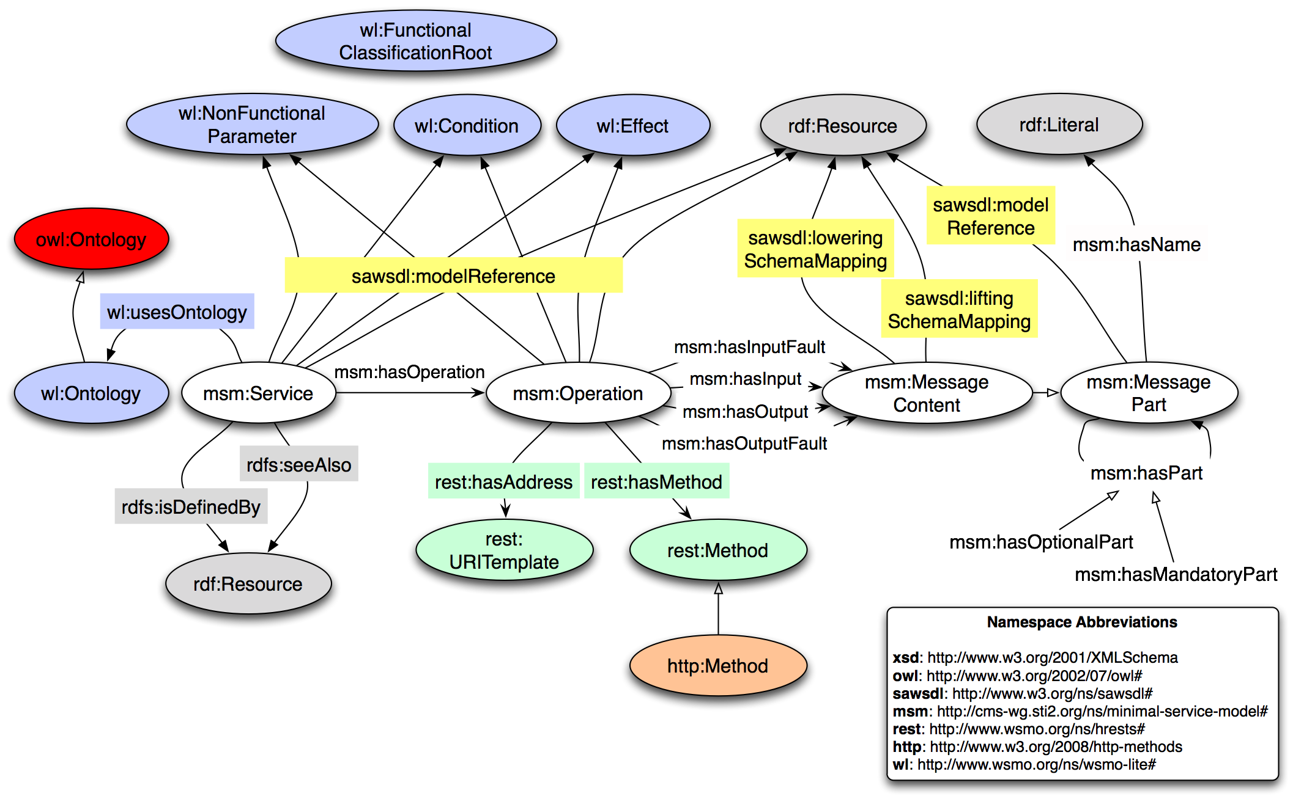
Minimal Service Model
Source: http://cms-wg.sti2.org/minimal-service-model/

Slide 10


Semantic Annotations for WSDL and XML Schema (SAWSDL)
Relate the Service and Message description to the meaning captured in an Ontology.
  Annotations can be applied to all WSDL elements and XML Schema types.
Define transformation between wired message format and the ontology representation.
XML Schema
Enterprise Vocabulary
<xsd:ComplexType name=“FlightTrack”
sawsdl:modelReference=“… …”
sawsdl:liftingSchemaMapping=“…”
sawsdl:loweringSchemaMapping=“…”>
ont:AirTrack
a rdfs:Class
… …
Import
XSLT
SPARQL+XSLT
WSDL
Service Ontology
<operation name=“getFlightTrack”
sawsdl:modelReference=“… …”>
svc:airTrackProvider
svc:payload ont:AirTrack
… …
<input message=”…”>

Slide 11
Alion Semantic Mediation Bus™
An ontology-based web services mediation component (Semantic Mediator) that enables services with different message formats to interoperate
Embedding the Semantic Mediator in an Enterprise Service Bus (ESB) enables runtime semantic mediation within traditional SOA infrastructure, creating the Alion Semantic Mediation BusTM
Common Ontology
Semantic Mediation BusTM
Enterprise Service Bus
Registry/ Repository
Semantic Mediator
Message Schema Mapping
Web Service Proxy
Semantic Lookup and Interoperability Assessment
Semantic Annotation
Metadata Management
Protocol Adaption
Message Transformation
Message Routing
Security
Service Discovery
Traditional SOA infrastructure
Semantic Mediation Infrastructure

Slide 12
Semantic Mediation: Dynamically Map Information to User Needs
Airline Code Lookup Table
Data: UA
Semantic Mediation Bus™
FAA
Web Service
HR Army
Field Name:
Commercial Flight
Data: 211
Flight Track Display
Reference
User
Semantic Lookup
Air Force
Web Service
Field Name: Flight of Interest
Data: UA211
Message Transformation
Common Air Track Ontology
Web Service Endpoint
3rd Party
Web Service
HR Army
Field Name:
FlightID
Data: United 211
HR Marine

Slide 13
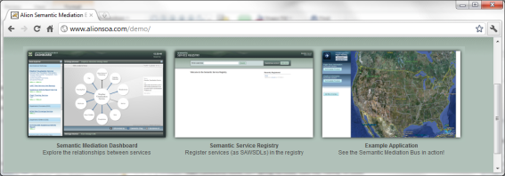
Semantic Service Mediation
Service Consumer
SOA Infrastructure
FAA
Dynamic Service Endpoint
Google Earth Client
Original
Track Data Provider
Alion Semantic Mediation Bus™
Message Transformation
Semantic Discovery
Interoperability Assessment
Air Force
Alternate
Track Data Provider

Slide 14
Key Characteristics
Cooperation through federation, instead of standardization
  The ontology driven approach avoids imposing a standard that has to be agreed by everybody, thus allowing the agencies to select the formats best suited for their business needs, while still being able to use services offered by other agencies.
Increased ability to adapt to the ever changing business needs in a timely and cost effective manner
  The semantic mediation approach encourages transformation logic to be declaratively defined in the ontology, instead of buried in the code, often in multiple places.
No need for rigid conformance
  Through loose coupling, the SMB allows transformation between message formats which might not be a complete match.
Building on SOA infrastructure, instead of replacing it
  By extending ESB infrastructure, organization can leverage their SOA investment and the existing expertise of their personnel.

Slide 15
Extensibility Considerations
Pluggable to SOA Platforms
  Integrate with existing Enterprise Service Buses (ESB)
  Interact with Service Registry (ebXML, UDDI, proprietary)
Adaptable to Service Design Choices
  Mediate SOAP-based Web Services
  Support REST and Plain XML Data
  Service Metadata
Provide Intelligent Mediation
  Assess service compatibilities based on semantics

Slide 16

Building Block for Enterprise Solutions
SLIDE 16
Enterprise Challenge: Data integration is as much an issue as in the inter-organizational context
  Data mash up solution from disparate systems
  Incorporation of unanticipated sources in business intelligence
  Enhancement of situational awareness through on-demand integration of data
Opportunity: Ontology is not only a tool for understanding, but also a basis for executable solutions

Slide 17
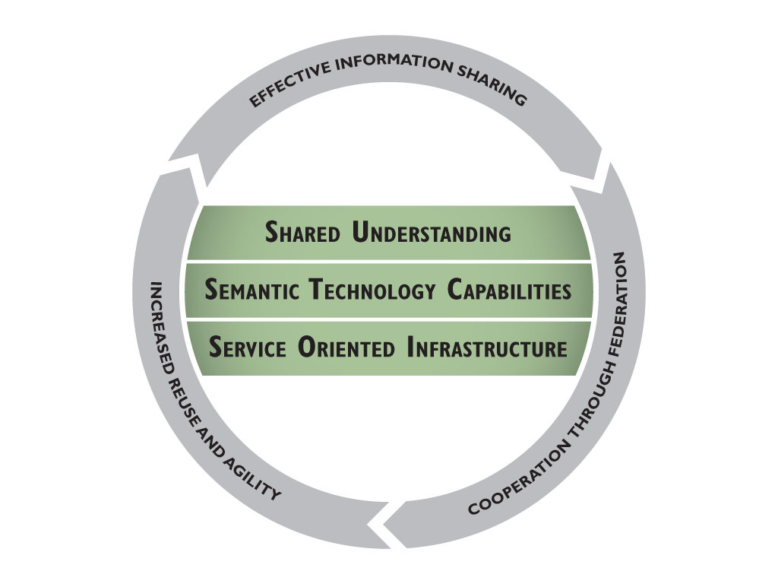
SMB as Part of a Semantic Enterprise
Ontologies reflecting Shared understanding of business concepts is developed by engaging the established Communities of Interest (COI) and Subject Matter Experts (SME).
SMB is part of the technology capability that extends traditional SOA to enable semantic service discoverability and interoperability.
Secure and effective IT infrastructure is the foundation for Net-Centric information sharing.

Slide 18
Summary
Put Ontologies to Work
  Enhance service understandability at design time
  Facilitate service interoperability at runtime
Leverage Existing SOA Investment
  Increase service discoverability and interoperability through semantic annotation
  Build on existing services
  Use in-house expertise
  Ready to deployed now
Streamline Service Integration
  Shorten development lifecycle by eliminating the need for custom message mapping
  Reduce maintenance cost by leveraging existing infrastructure

Slide 19

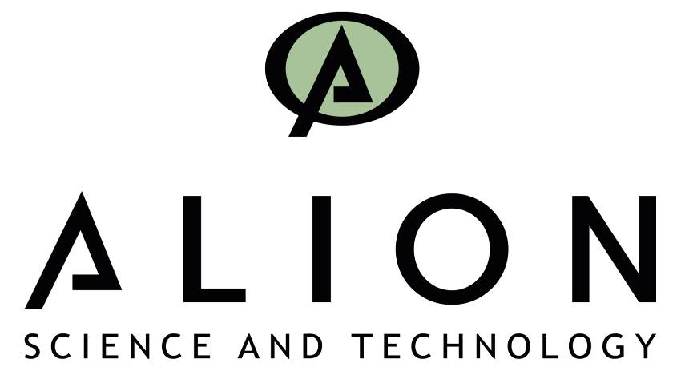
www.alionscience.com

